Slide 1

Snowflake Architecture
By
Janardhan Bandi

Slide 2
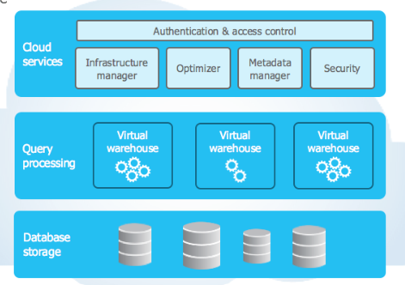

Slide 3
Database Storage Layer:
Stores table data and query results
Data will be stored in columnar format
Data will be stored in micro partitions
Snowflake manages all aspects of how this data is stored i.e. the data organization, file size, structure, compression, metadata, statistics
The data objects stored by Snowflake are not directly visible nor accessible by customers; they are only accessible through SQL query operations run using Snowflake.
We can define cluster keys on large tables for better performance.

Slide 4
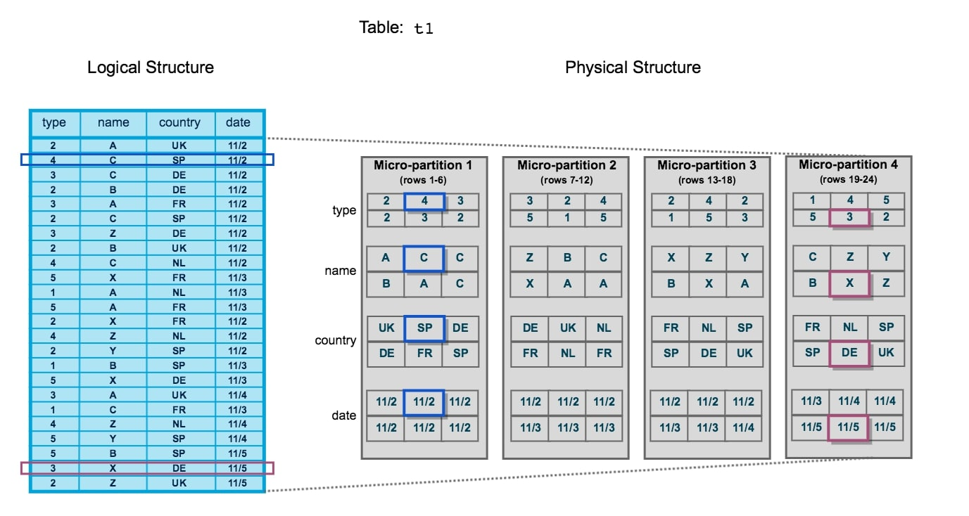

Slide 5
Query Processing Layer:
This is the actual processing unit of snowflake
Snowflake processes queries using “virtual warehouses”
Each virtual warehouse is composed of multiple compute nodes allocated by Snowflake from a cloud provider.
On AWS they are a group of EC2 instances and on AZURE a group of Virtual Machines
Compute cost will be calculated on the basis of query execution time on virtual warehouses
Virtual Warehouses are considered as the muscle of the system
Can scale up and scale down easily
Auto-Suspend and Auto-Resume is available

Slide 6
Cloud Services Layer:
Collection of services that coordinate activities across Snowflake
This is the Brain of the snowflake
Authentication and access control
Infrastructure management
Metadata Management
Security
Manages all Serverless tasks like Snowpipe, Tasks, Materialized view maintenance etc.

Slide 7
Connecting to Snowflake
Snowflake supports multiple ways of connecting to the service:
A web-based user interface from which all aspects of managing and using Snowflake can be accessed.
Command line clients (e.g. SnowSQL) which can also access all aspects of managing and using Snowflake.
ODBC and JDBC drivers that can be used by other applications (e.g. Tableau) to connect to Snowflake.
Through native connectors available in ETL tools (e.g. Datastage, Informatica)

Slide 8
Thank you

